Slide 1

Transportation Engineering Laboratory
Prepared by group 4
Topsis Algorithm
Praveen Jangir (23CE10042)
Prince Choudhary (23CE10044)
Priyanshu Verma (23CE10045)

Slide 2
TOPSIS
Technique for Order of Preference by Similarity to Ideal Solution
•TOPSIS is a multi-criteria decision analysis method
•Originally developed by Ching-Lai Hwang and Yoon in 1981
•Further developed by Yoon in 1987, and Hwang, Lai and Liu in 1993
•Based on the concept that the chosen alternative should have the shortest geometric distance from the positive ideal solution (PIS) and the longest geometric distance from the negative ideal solution (NIS)
•Salient features of TOPSIS :
ØSimple, Comprehensible
ØGood Computational efficiency
ØAbility to measure the relative performance for each alternative in a simple mathematical form
.

Slide 3
Problem Statement
Choosing a route from pre existing routes for travelling in IIT Kharagpur from Patel Hall of Residence to Nalanda Classroom Complex by TOPSIS Algorithm.

Slide 4
Based on importance we choose certain criterias/parameters as
follows:
Length of the route
Travel time
Number of lanes in the route
comfort
Average Annual Daily Traffic (AADT)

Slide 5
Some factors need to be maximized
while some need to be minimized.
In our case, no of lanes and comfort is to be maximized and other criterias like travel time, length and annual average daily traffic are to be minimized.

Slide 6
Order of preference & Weights
We choose the weights manually but intuitively
Travel time – 0.3
Average Annual Daily Traffic – 0.1
Length of the route – 0.2
Number of lanes in the route – 0.1
Comfort – 0.3

Slide 7
From the previous slide we find that for choosing the routes travel time has highest and no. of lanes has lowest preference
Now let’s say we have four routes :
A, B, C, D
All of them serve the purpose of transportation from the Patel Hall of Residence to the Nalanda classroom complex. But they differ in various criteria. They have their own pros and cons. Hence, we will use the TOPSIS Algorithm to help us choose the right route based on the order of preference.

Slide 8
Route A- Patel -> MMM -> LLR -> MS -> RK -> Main Building -> Civil Engineering Department -> Nehru Museum -> Nalanda
Route B- Patel -> Gymkhana -> Gate1 -> Clock Tower -> Takshshila -> Nalanda
Route C- Patel -> Gymkhana -> Pepsi cut -> Clock Tower -> Takshshila -> Nalanda
Route D- Patel -> BC Roy Hospital -> Clock Tower -> Takshshila -> Agricultural Department -> Nalanda

Slide 9
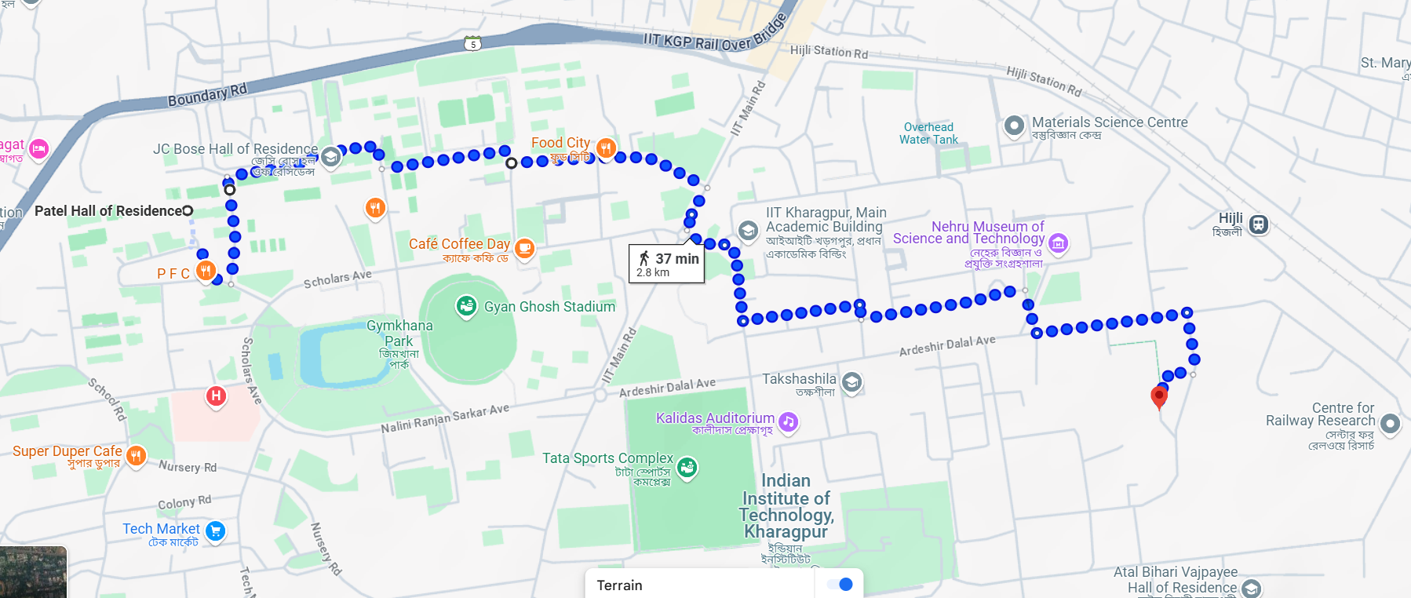
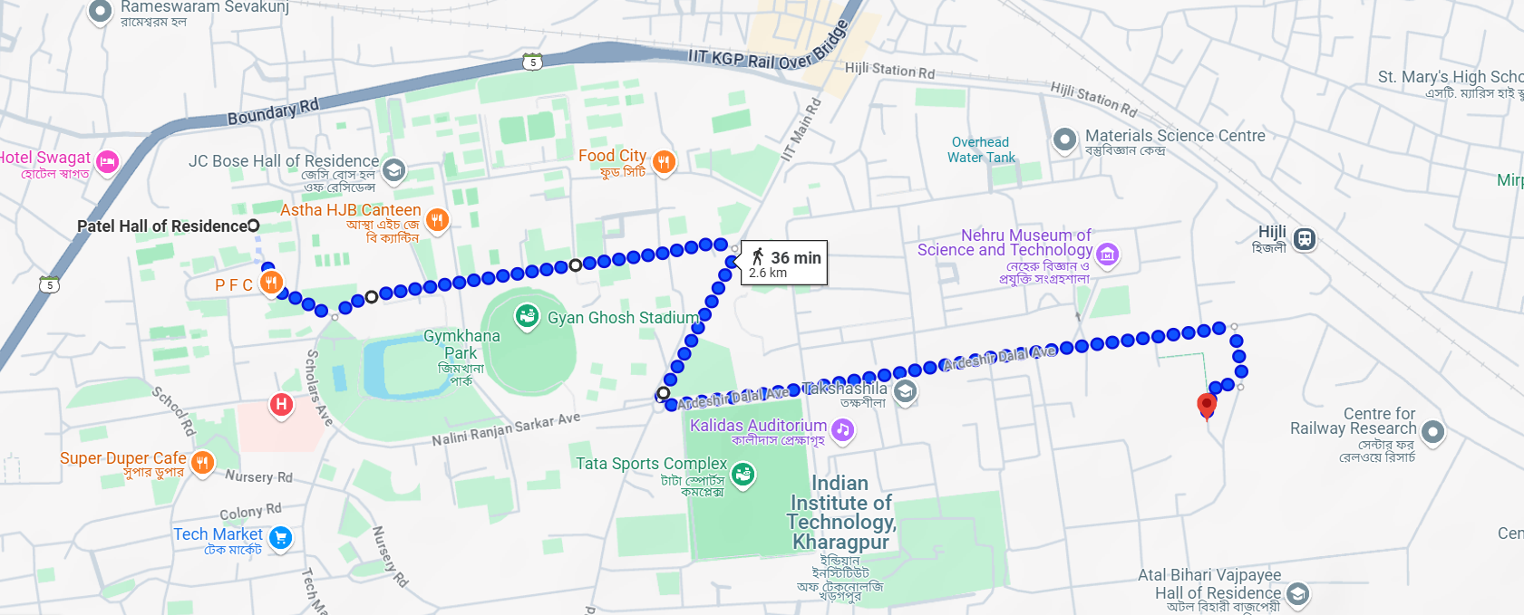
Route A
Route B

Slide 10
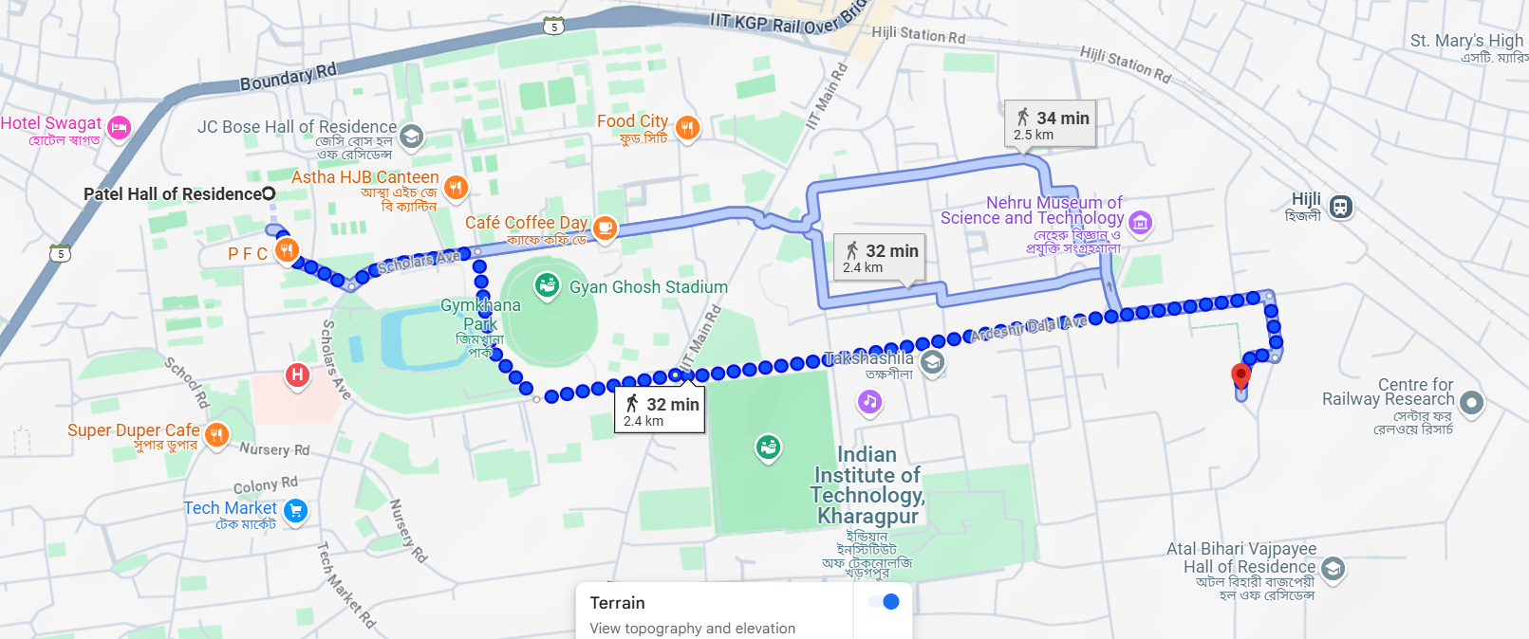
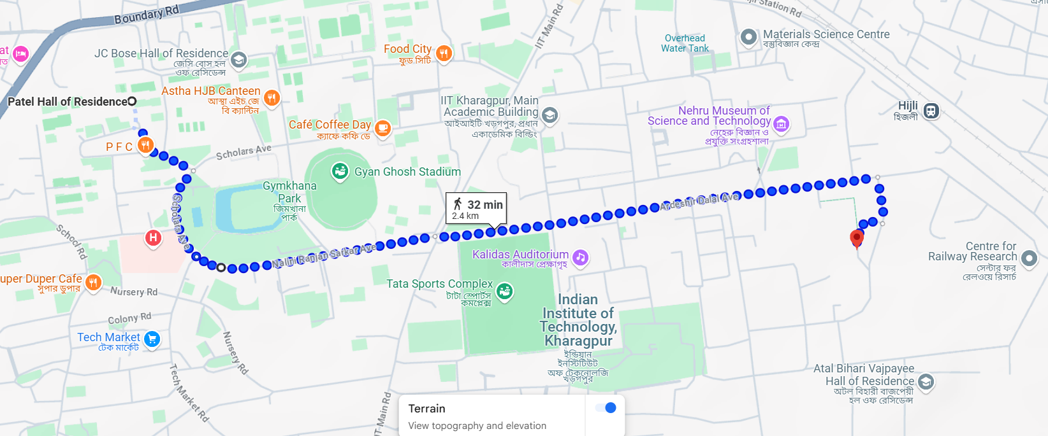
Route C
Route D

Slide 11
Below shown is a table displaying the value of each criteria with respect to each alternative route :
 | Travel time (mins) | AADT | Length of route(km) | Number of lanes | comfort
A | 15 | 4000 | 2.4 | 2 | 0.75
B | 17 | 5000 | 2.6 | 2 | 0.7
C | 16 | 4500 | 2.5 | 2 | 0.9
D | 18 | 5500 | 2.6 | 4 | 0.8

Slide 12

A) Normalization of the Decision Matrix :
 | Travel time | AADT | Length of route | Number of lanes | Comfort
A | 0.45375 | 0.41816 | 0.47499 | 0.37796 | 0.47410
B | 0.51425 | 0.52270 | 0.51457 | 0.37796 | 0.44249
C | 0.48400 | 0.47043 | 0.49478 | 0.37796 | 0.56892
D | 0.54450 | 0.57497 | 0.51457 | 0.75592 | 0.50571

Slide 13
B) Multiplying columns with corresponding weights
 | Travel time | AADT | Length of route | Number of lanes | Comfort
A | 0.136125 | 0.041816 | 0.094998 | 0.037796 | 0.14223
B | 0.154275 | 0.052270 | 0.102914 | 0.037796 | 0.132747
C | 0.145200 | 0.047043 | 0.098956 | 0.037796 | 0.170676
D | 0.163350 | 0.057497 | 0.102914 | 0.075592 | 0.151551

Slide 14
C) Ideal and Anti-Ideal solutions based off criteria, for a criteria that needs to be maximized the maximum value is the ideal and for a criteria that needs to be minimized the minimum value is the ideal and vice versa
 | Ideal Solution | Anti-Ideal Solution
Travel time | 0.136125 | 0.163350
AADT | 0.041816 | 0.057497
Length of route | 0.094998 | 0.102914
Number of lanes | 0.075592 | 0.037796
Comfort | 0.170676 | 0.132747

Slide 15
Now for each route, we assign two variables: S+ and S_ where S+ is the distance from
the ideal solution and S_ is the distance from the anti-ideal solution
For S+ for each alternative route, we find the square root of the summation of squares
of the difference between each criterion from the weighted matrix and its ideal value
For S_ for each alternative route, we find the square root of the summation of squares
of the difference between each criterion from the weighted matrix and its anti -ideal value

Slide 16
By calculation we get :
Sa+ = 0.04730, Sb+ = 0.05803, Sc+ = 0.03941,
Sd+ = 0.03276
Sa_= 0.03365, Sb_ = 0.02142, Sc_ = 0.04653,
Sd_ = 0.04221

Slide 17
Then we calculate the relative closeness co-efficient by the formula :
Si_ /(Si_ + Si+)
We do this for each alternative, at the end the alternative having the maximum value of the closeness co-efficient is
considered to be the best possible outcome.

Slide 18
By calculation, we get the Relative closeness factor for
A = 0.4156
B = 0.2696
C = 0.5414
D = 0.5630
So, the best alternative will be the one that have maximum value of closeness coefficient. In our case it is path D .
Order of preference of routes is D>C>A>B

Slide 19
Route D

Slide 20
Research analysis
Evaluation of optimal route selection for public transport network routes on urban roads using Fuzzy-Topsis method
Summary
The problem of traffic is a major concern in rapidly growing Bengaluru city. Here is an analysis of a research done on this problem for the journey from Kempegowda International Airport, Bangaluru to Central Business District.
In this case, in addition to the existing route, two alternate routes AR1 and AR2 have been taken in account. The attributes are Length, Travel Time, Road Width, No. of Buildings to be demolished, Buffer Area, Trees to be cut, Impact of side friction.
The weights used are 0.3344, 0.2611, 0.2291, 0.0396, 0.0396, 0.0479 and 0.0479 for Length, Travel Time, Road Width, No. of Buildings to be demolished, Buffer Area, Trees to be cut, Impact of side friction respectively. Using all the data, normalised the matrix and then calculated weighted normalised matrix. Then positive ideal and negative ideal solution were determined and thereafter the distances of the alternatives from them. In the end, relative closeness coefficient was calculated and it was found that the alternate route 1 i.e. AR1 has maximum value of the relative closeness coefficient that is 0.7246, so alternate route 1 is the best suitable option.
The values of parameters for this route are 36.35km, 1hr 35min, 20, 140, 726961, 7090 and medium for Length, Travel Time, Road Width, No. of Buildings to be demolished, Buffer Area, Trees to be cut, Impact of side friction.

Slide 21



Thank
You

